Slide 1
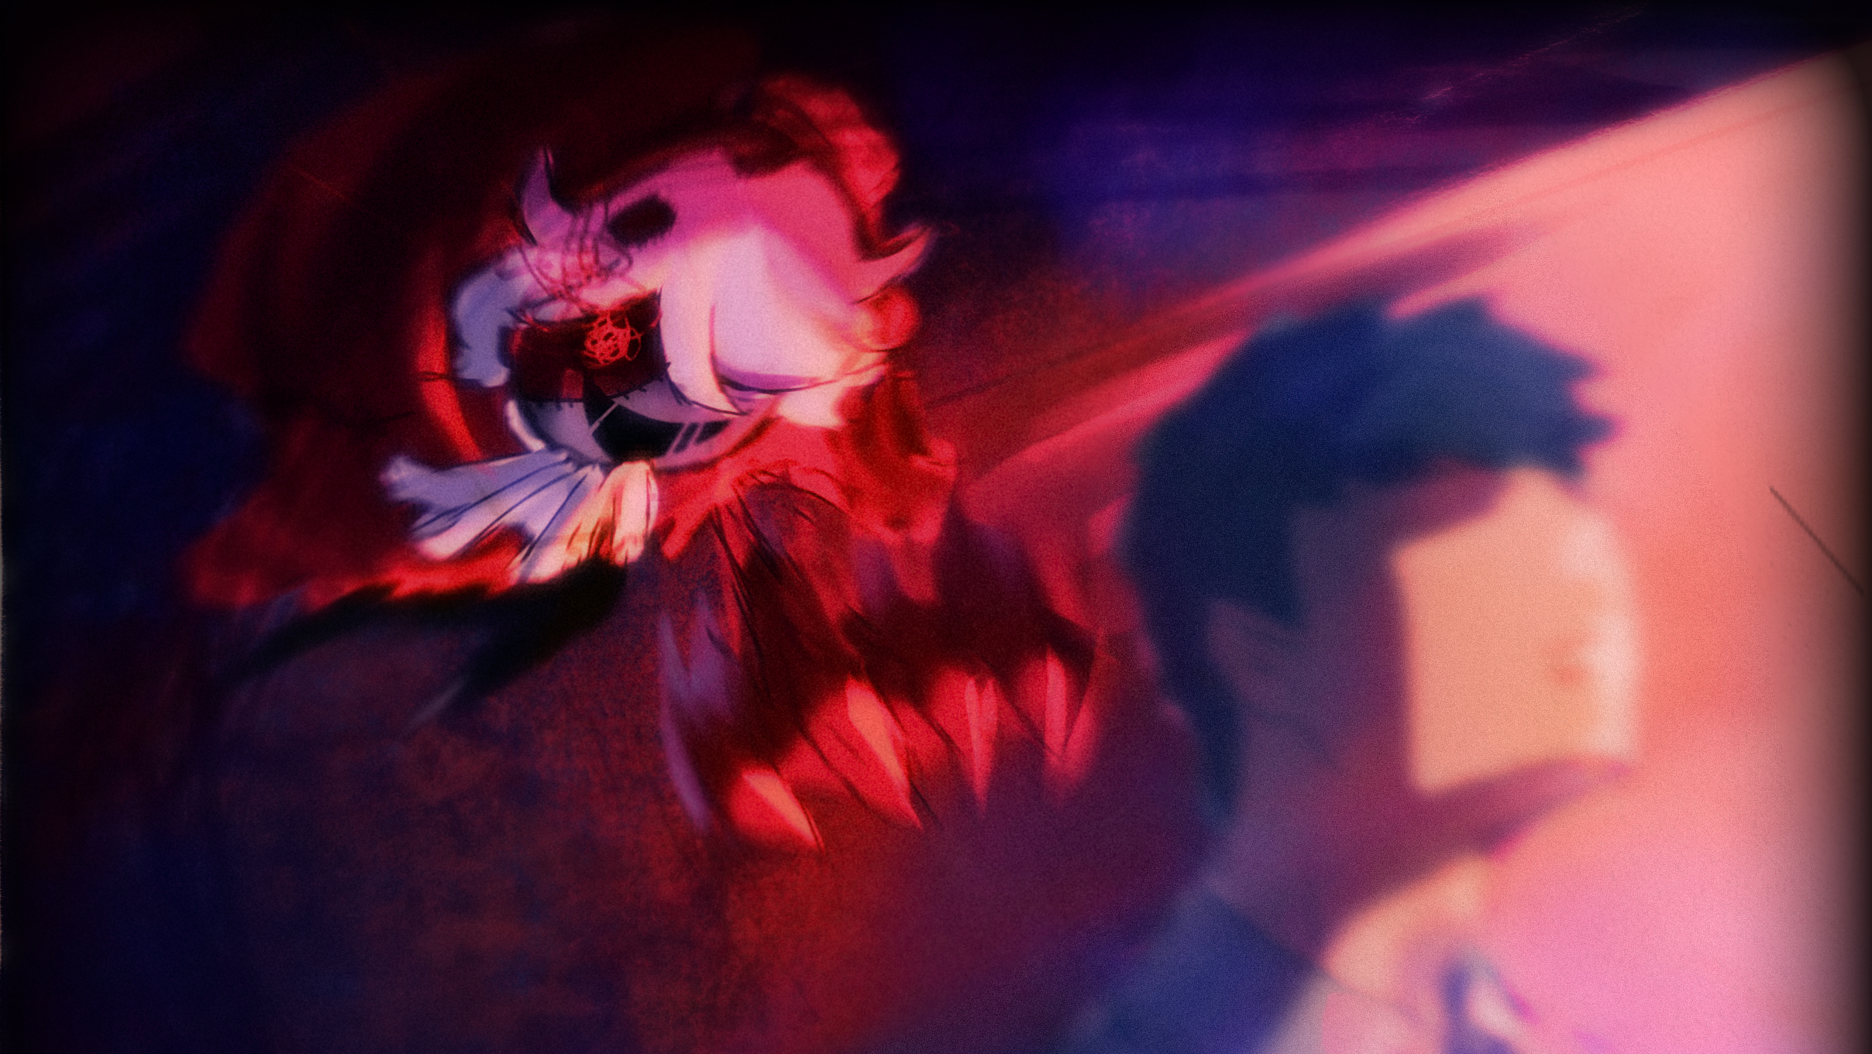
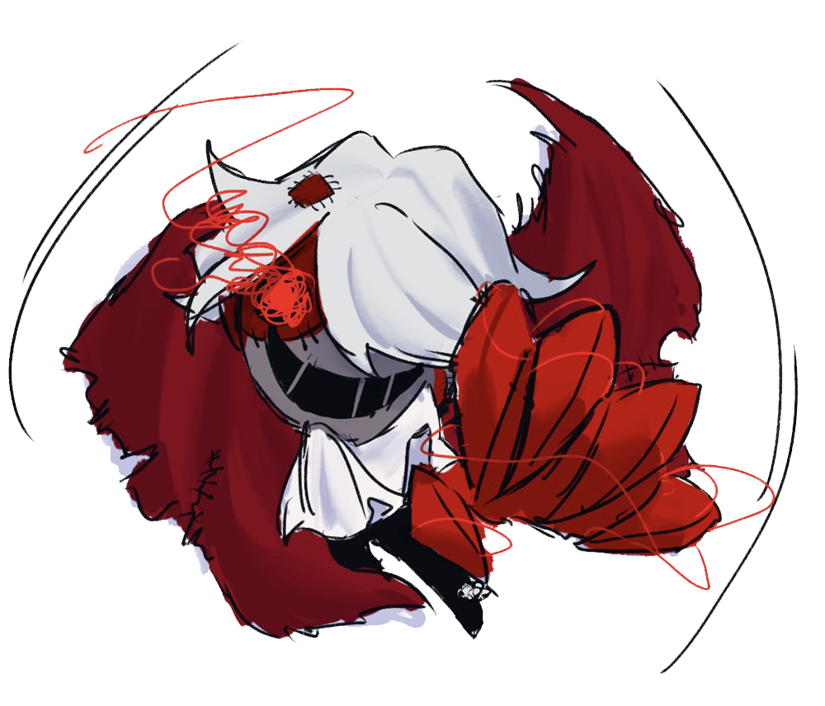

PUPPETEAR
GD06 GROUP

Slide 2
Game ID
Game Name: Puppetear
Market: Stealth Strategy Indie games
Game Genre: Stealth、Strategy、Violence、Evil Main Character
Platform: PC
Audience:18+
who like challenges and conquer
are interested in stealth strategy games
Release Date:2021.2.28

Slide 3
Our Team
Project Manager:
Jeff
Artist：
Jenifer、Lyon
Designer:
Nico、Nan、Ricardo、Arno
Programmer：
Jesson、Jeff、Lyon、Nan

Slide 4
TimeLine
Vertical Slice
1/31/21
Demo
1/17/21
Alpha
2/28/21
Prototype
1/7/21
Pitch
12/1/20
W1
W2
W3
W4
W1
2021
W2
W3
W4
W1
W2
2021.3
2020.12
Today

Slide 5
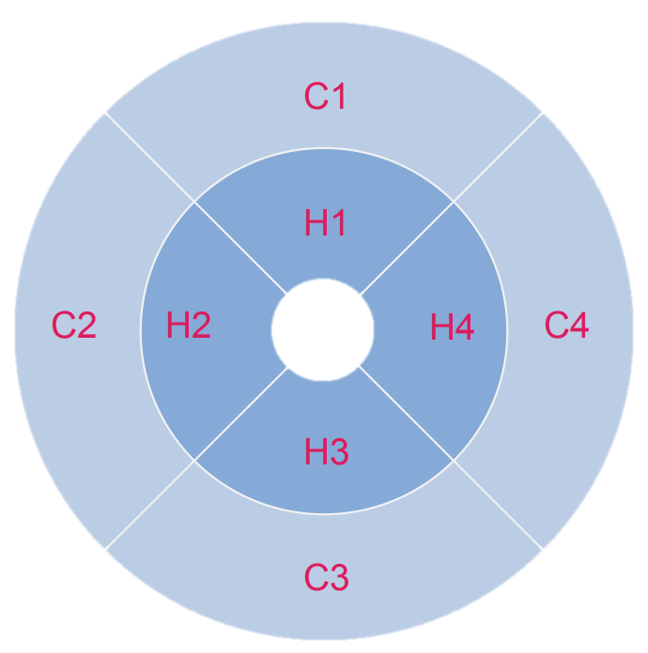
Target Audience
Thinking
conflict
task
process-
orientation
goal-
orientation
Perceiving
Judging
subjective experiences
emotional states
Conqueror-Hardcore：
Desire to see and complete everything
Feeling

Slide 6
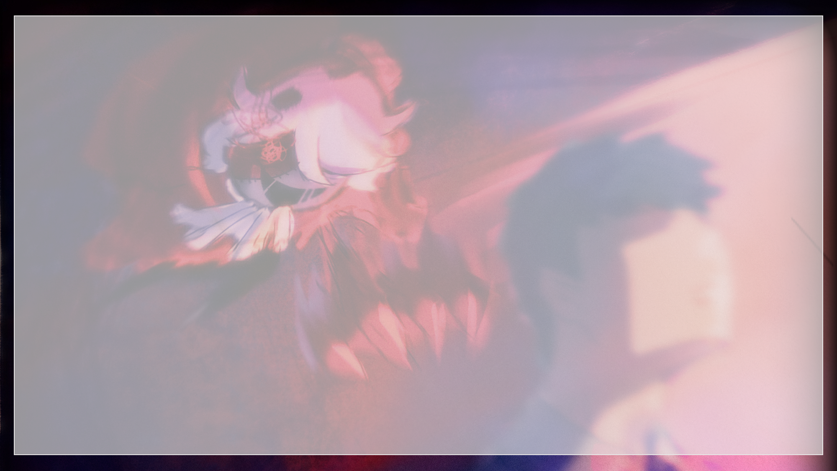
Narrative

Slide 7

Game Story
The little boy lost his home and family because of the demolition accident.
The little boy woke up to find his soul trapped in his body!
All unwilling and aggrieved burst out at this moment, the little boy decided to revenge with the doll's body!

Slide 8
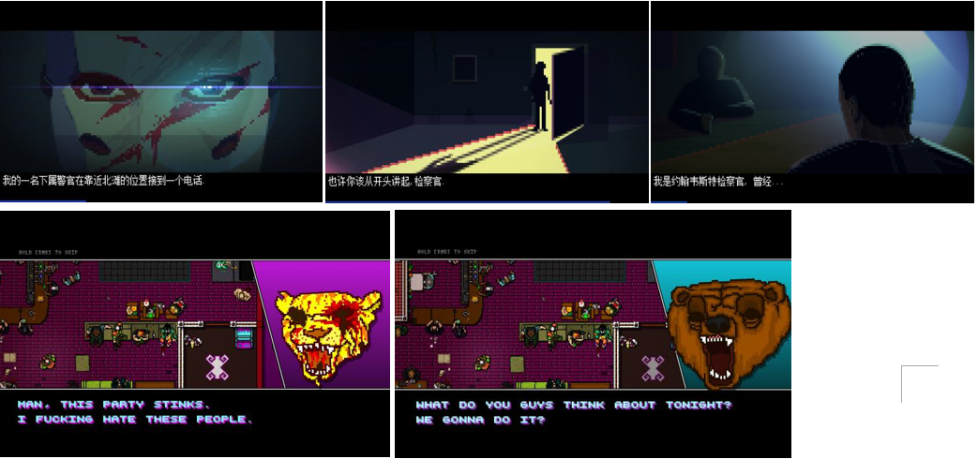

Story expression
Picture and text narrative;
Style:
cinematic narrative;
Interactive:
you can press the space to skip sentence by sentence, or long press the space to skip the whole paragraph.
Plan A
Press
Skip
Long Press
Skip whole

Slide 9
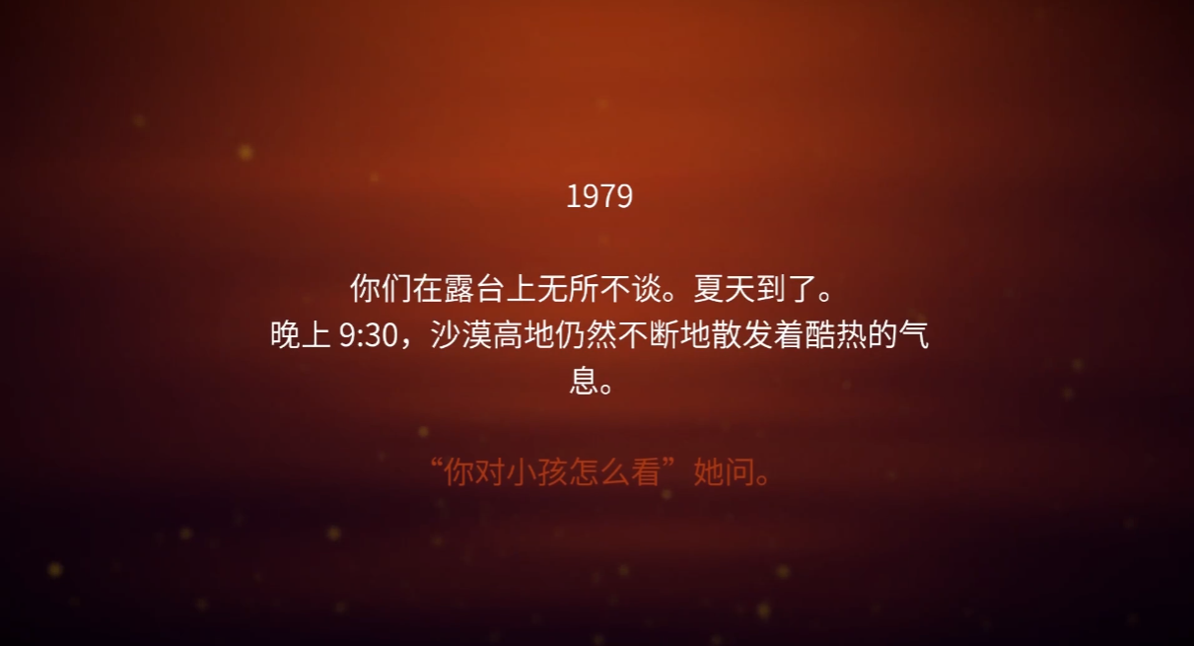
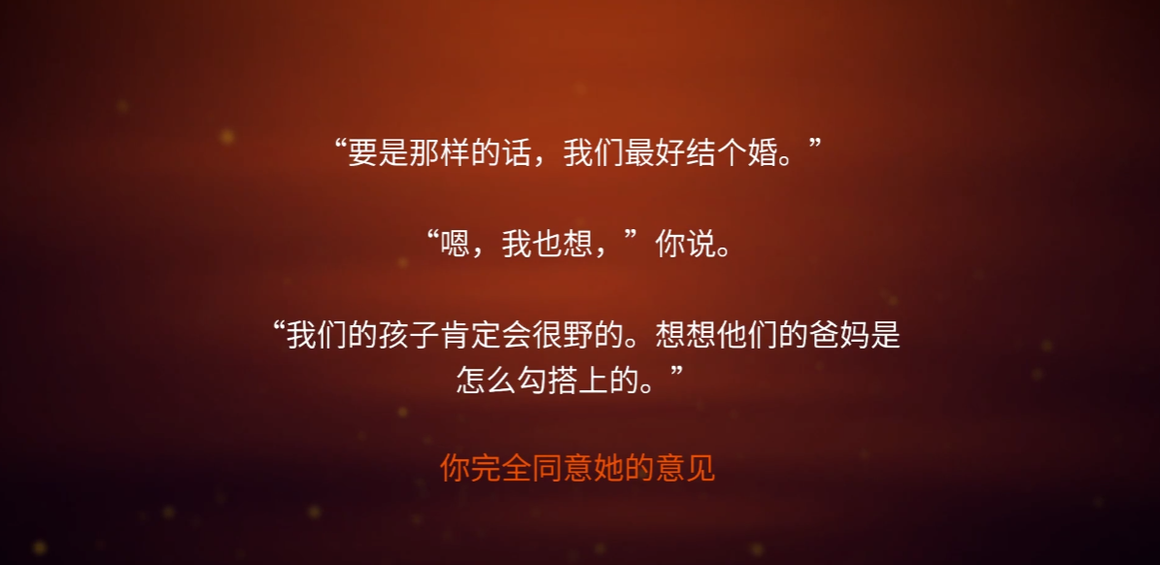
Story expression
Plan B
Text narrative;
Style:
First-person narrative; Boy narration
Interactive:
Collect: Cut scenes / texts explain the general background of the story, and a series of collection files are used in the game to supplement the ins and outs of the whole event
Object: Mail in the computer;
forms on the desk ;
newspaper;
news on TV, etc.
Press
Skip
Long Press
Skip whole

Slide 10
Game Art

Slide 11
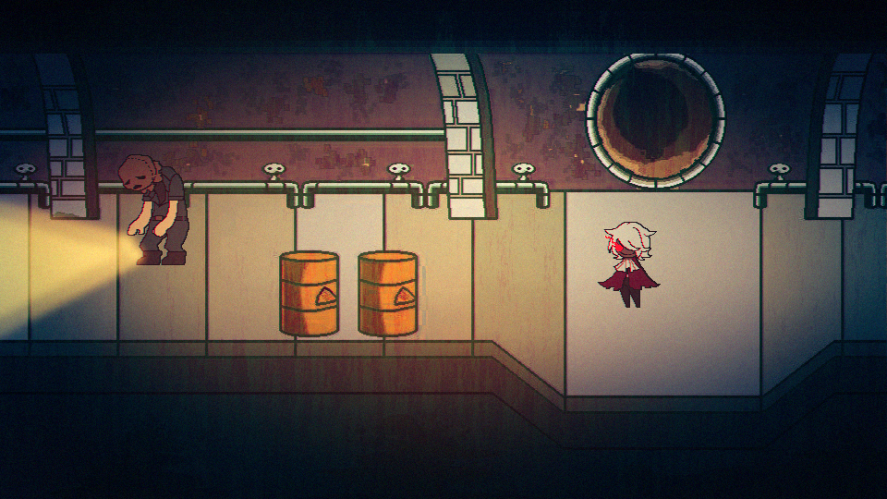
The main characters to gothic-based, in order to match the theme of revenge, the main tone are dark.

Slide 12
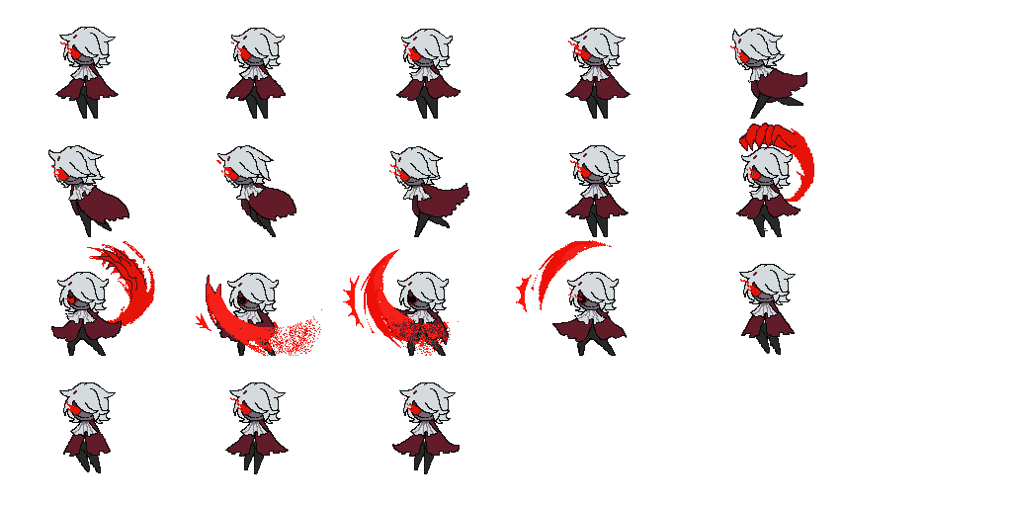
Ripper
the protagonist is a common doll, in the boy’s lodging under the grim, broken doll from the eyes of the blood-red overflow line, that is, he came from the soul of malice, but also his harvest of weapons.
Patches, torn cloaks, messy hair, crooked smiles

Slide 13
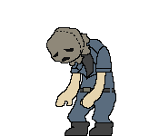

Humans
the human image is slightly deformed, highlighting its most obvious features

Slide 14
Game Play

Slide 15
Game Play
RULES:
1.The player controls the doll to successfully kill all targets without being found in the specified scene (level) and keep the doll alive;
2. After killing the target, the doll can get growth points. Killing in a special way will give you a bonus. The direction of growth can be chosen by the player;
3. Materials obtained randomly after killing the target. Collecting the materials of the weapon formula can create new weapons for the doll to assist the doll to achieve the goal of killing;

Slide 16
Key Features
A. Avoid being found and kill target to survive
B. Doll’s life will go by over time
C. Dolls have their own growth attributes
D. Use all kinds of weapons to find your best way to kill

Slide 17

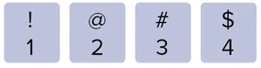
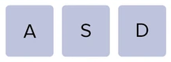
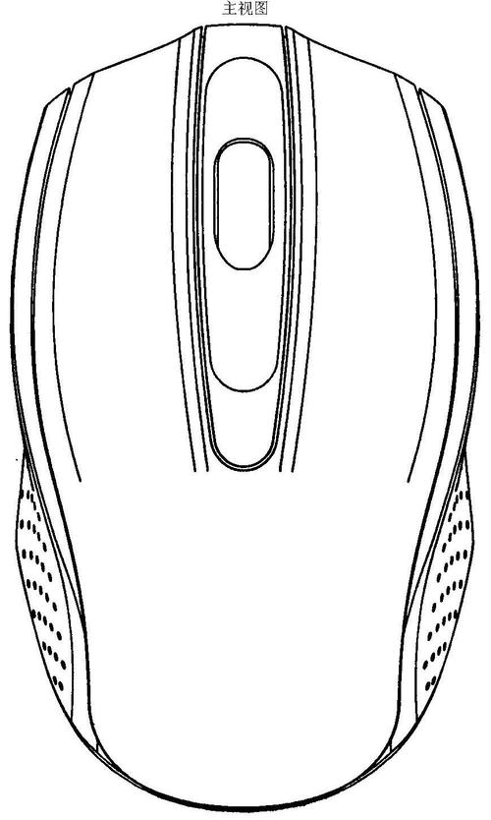

Control
Scroll: Quick switch weapons
Switch weapons
Movement
Click/Hold: Attack
Hold: Aim
Interact

Slide 18
Game Mechanics

Slide 19
Move & REFLEXES
Reflexes: Players need to observe the behavior of the NPC to hide or move out of the NPC's line of sight
Normal Walk:
Normal speed walk;
Run:
The speed of the puppet grows to a certain value, Ordinary walking will change to accelerate running;

Slide 20
Timing
Doll’s life will go by over time, equal to a timer for the players;
You need to kill people to gain health before the doll's health is reduced to 0
Every time you kill a person, you will get a certain amount of health, which increases the time for the player to pass the level.
Complete the level goal while the doll is alive and win

Slide 21
Cleverness & tactical
The level provides various triggers of various organs as a special way of killing
Players need to observe the objects in the level to find the trigger method of the mechanism.
Players can freely choose to kill the target after approaching the NPC or use the opportunity to kill people

Slide 22
Economy system

Slide 23
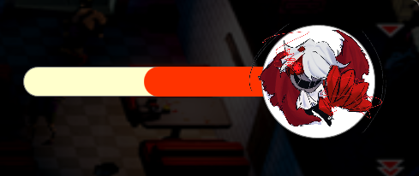
Life Timer
The survival value of the doll will decay over time
IF the value = 0, game Over;
Else you can continue the game;

Slide 24
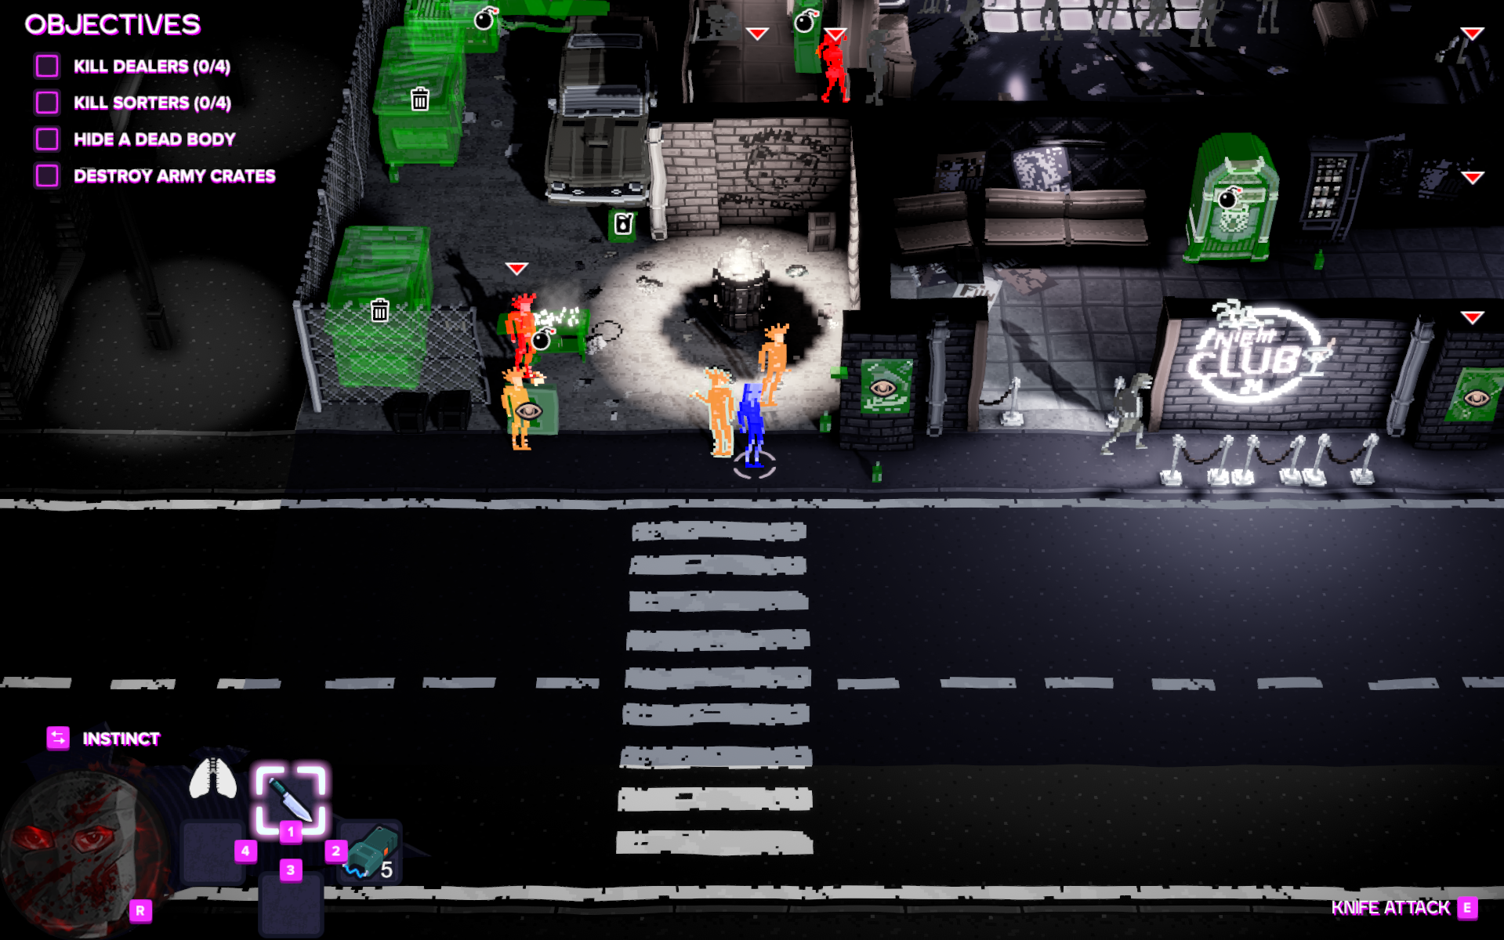
Skill Points
Speed
Survival time
Hidden_Ablility
Wisdom
Move speed, upgrade so can move faster
The time when the doll can act, can skill people
Ability not easily found by NPC
Discover the ability to interact with traps;
The points gained are cumulative, and the points are related to the number of successfully killed targets; And related to the method of successfully killing the target; traps kills have more bonuses to skill points;
Active use player trigger
The upgrade is the number of views

Slide 25
Collect materials
1.The dropped items are randomly obtained by the player after killing the target
2.The player can pick it up and it will be consumed after the weapon is built
3.Pick up enough quantity in the weapon formula to make it
4.When this material is no longer needed, the material will be converted into skill points and randomly dropped

Slide 26
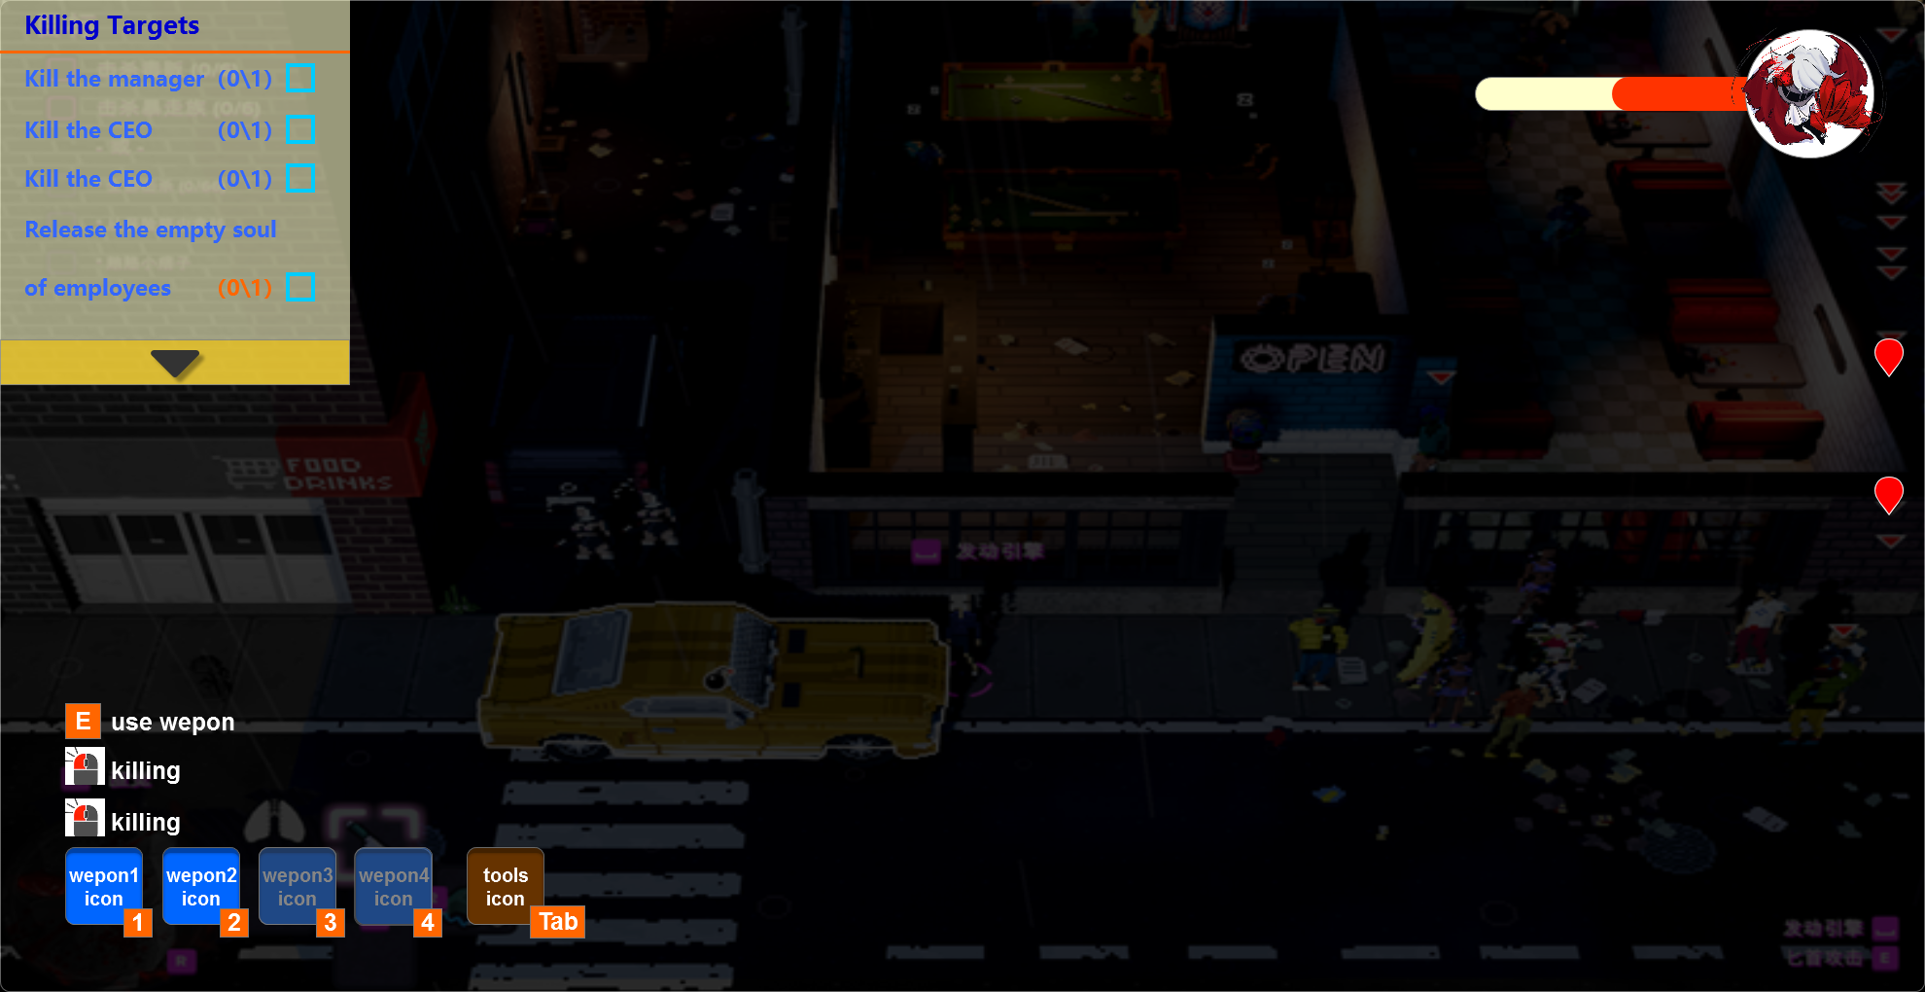

GAME Main UI
The doll’s life time bar will automatically decay
Target display
When the target goes out of the current camera, the hint will come to the edge
Drop-down menu
(don’t need now)
Operating instructions for current weapons
Watch out police
Weapon switching tips
Button to enter the item menu
Button to enter the item menu

Slide 27
W eApon system

Slide 28
Weapon Design
Gameplay: Players will control the puppet and move around the map, killing targets with the transformable arm without being detected.
The weapons will only be displayed in UI except during the state of interaction and killing.
Use the number keys 1~4 to switch weapons, the current action must be done before the weapon actually switches, when switching the weapon, players can move around, but can't kill or interact.

Slide 29
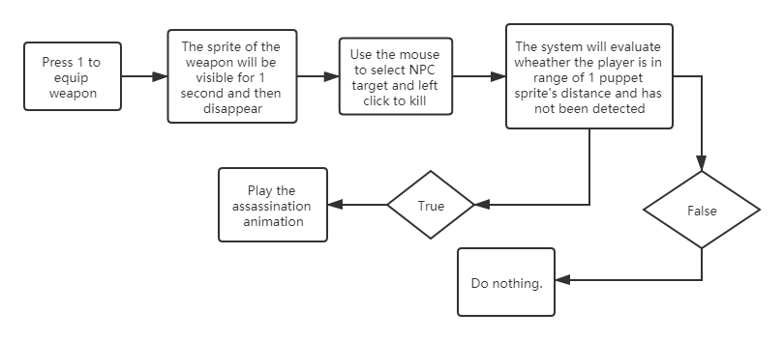


Weapon 1: Red Queen
Type: The original weapon, close range, direct kill
How to use: Sneak on targets with out been detected, kill them then in range
Range: 1 puppet sprite distance
Weapon reference
VFX reference

Slide 30
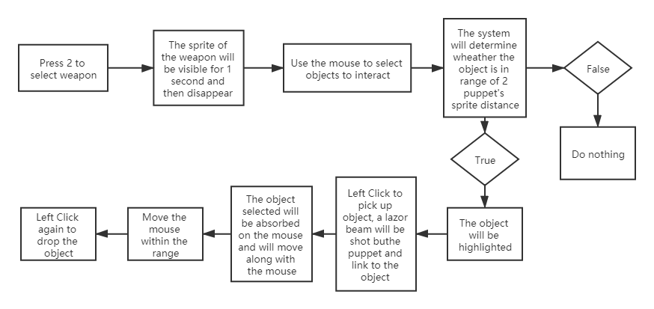
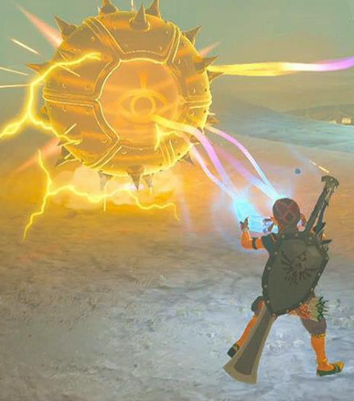
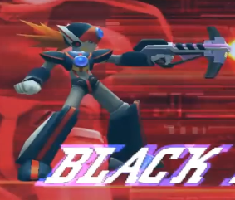
Weapon 2: Super Sticky
Type: The 2nd weapon, long range, can stick and move metal objects
How to use: Select the items, drag and place.
Range: 2 puppet sprite distance
Weapon reference
Lazar
reference

Slide 31
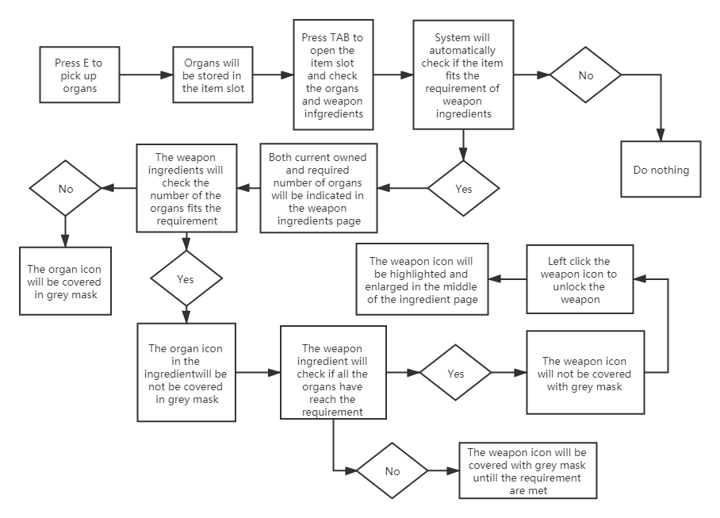
Weapon Build
The system will automatically check the number of organs and consume them to build the weapons
The player is only able to build 1 weapon at a time in a set order, for example, the 4th weapon won't be able to be built until the 3rd is built.

Slide 32
Tools system

Slide 33
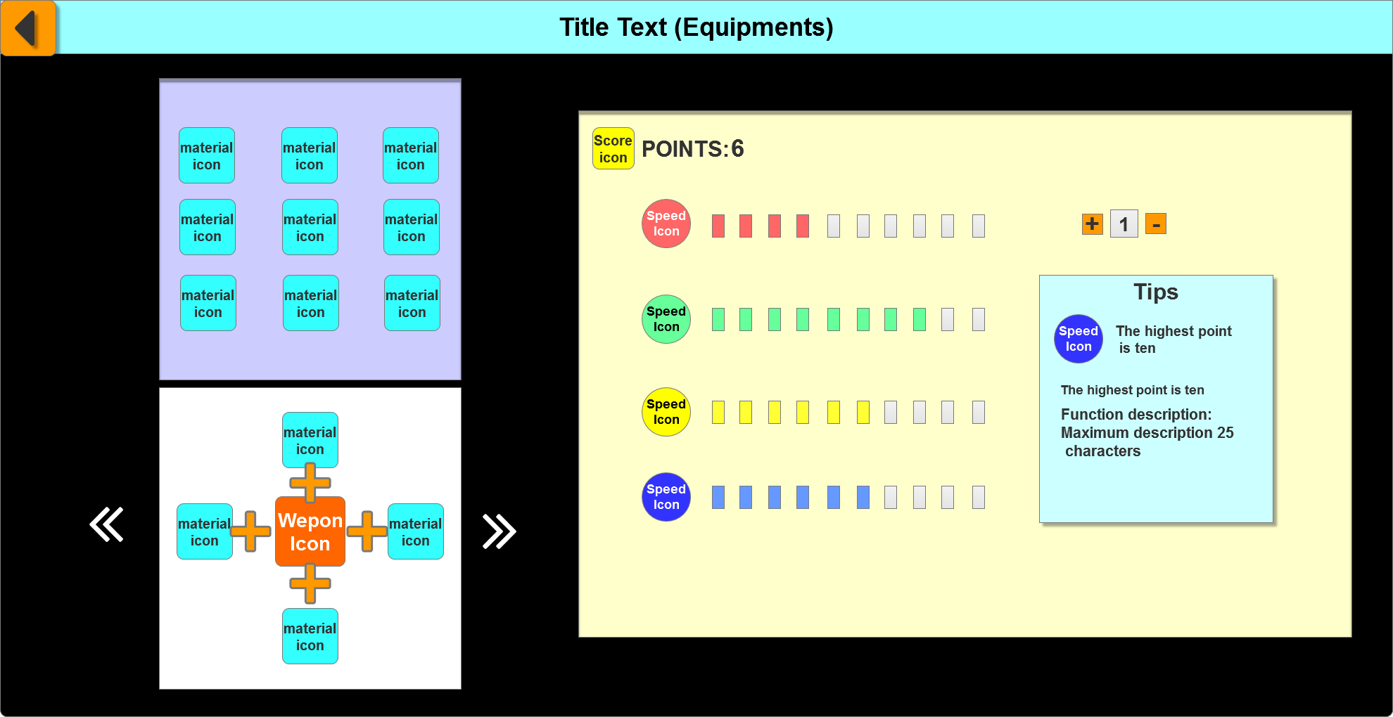
Item slot page indication
The system will automatically check the number of organs and consume them to build the weapons
The player is only able to build 1 weapon at a time in a set order, for example, the 4th weapon won't be able to be built until the 3rd is built.

Slide 34
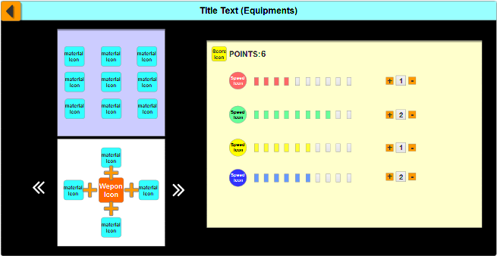
Build weapons
Title
Button:
Back to game
Display interface of collected weapon manufacturing materials.
Button: Click the button to add points
Attribute value: one point fills one
Weapon Manufacturing Interface
Icon: Attribute icon

Slide 35
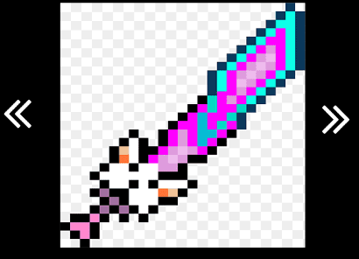

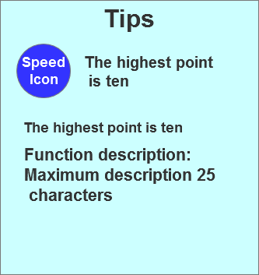

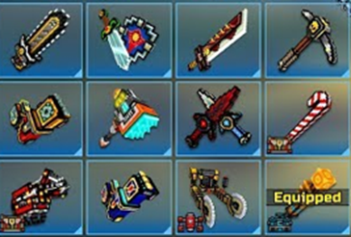
Build weapons
Icon Reference

Slide 36
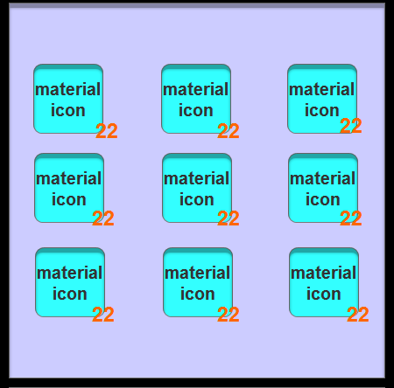
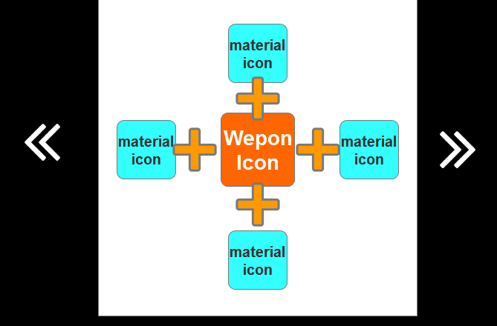
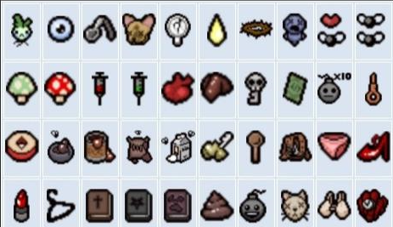
Instructions for use of the prop bar
The number of the same organs will be indicated on the bottom right corner
The organs will be automatically filled in the weapon ingredient section
The organs that doesn't fits the requirement will be covered with a grey mask
Left click the arrow to switch ingredients

Slide 37
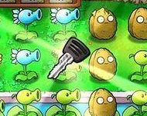
Weapon production instructions
When all requirements are met, left click on the weapon icon to acquire it, the weapon icon will be enlarged and moved to the center of the ingredient section with glowing effects.
When switch on the built weapon, there will only be the weapon icon indicated on the section
When switch on the unbuilt weapon, the whole section will be covered in grey mask, and the organs gained won't fill in as well

Slide 38
Tutorial

Slide 39
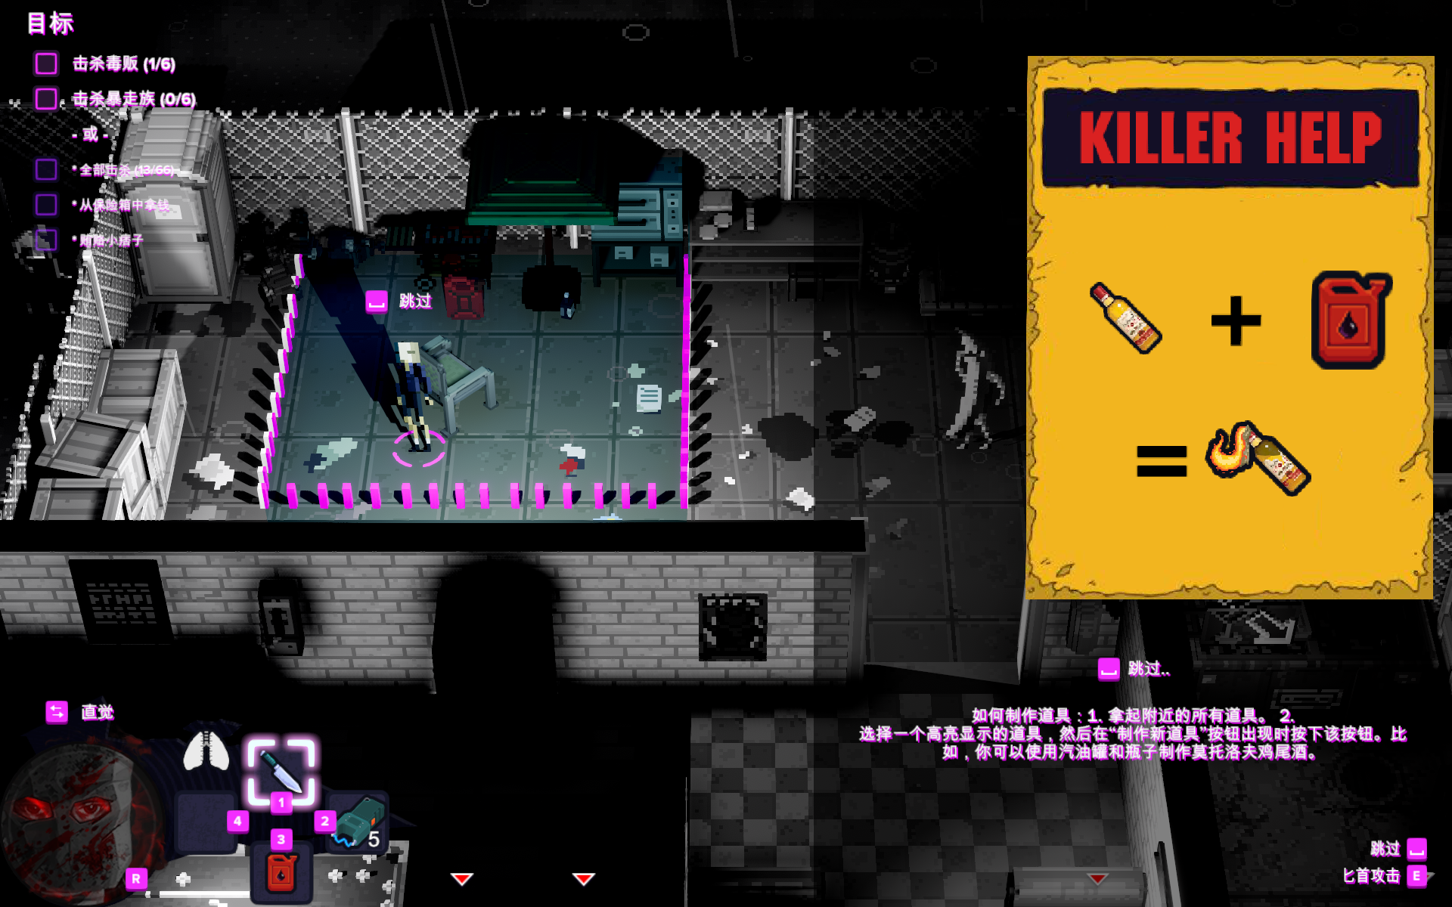
Get tips and guidance for new weapons
获得新武器的提示和引导：
1.范围的框选可以选做；
2.需要制作道具的场景上可以放置说明的Trigger;
3.触发之后，会弹出道具组装的流程，
此步骤用于手臂的制作；
当玩家收集完杀人之后产出的道具集齐之后，可以制造手臂，可以在此时在关卡中放置一个trigger,来提示玩家关于武器的制作；

Slide 40
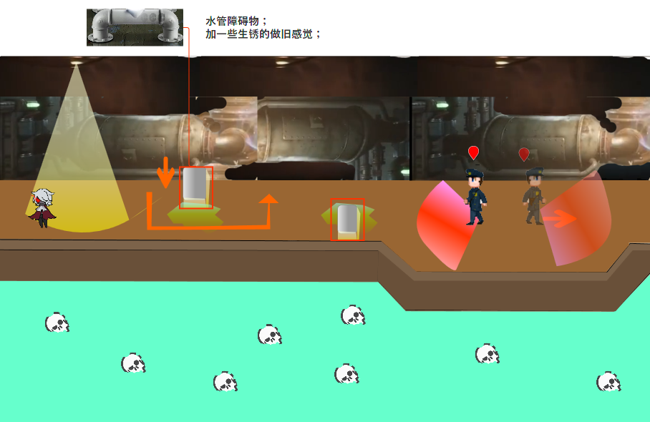
Operation guide
After the NPC rotates to a certain angle, the time to assassinate will prompt the player to operate
Doll's birth point
Guide the player to move up
and down and left and right
E
Killing
First killing people;
Obstructed
Water pipe
NPC behavior:
hint
NPC behavior:
Move left and turn around move right!

Slide 41
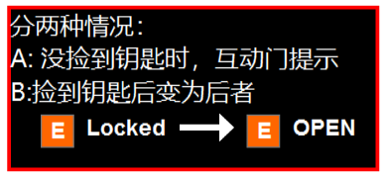
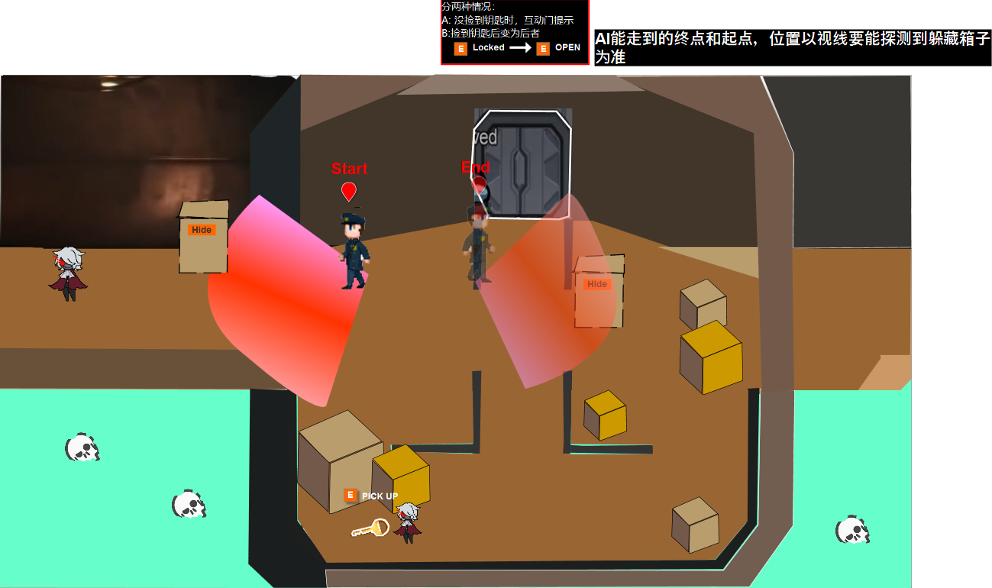
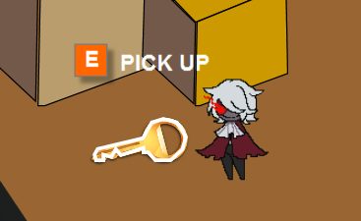
This scene reminds the player of our game perspective range
Target: get the key;
Open the lock gate
Use key open the elevator
Transform scene
The box labled “Hide” player
Can hide in there,从左往右，玩偶若无遮挡就会被检测到

Slide 42

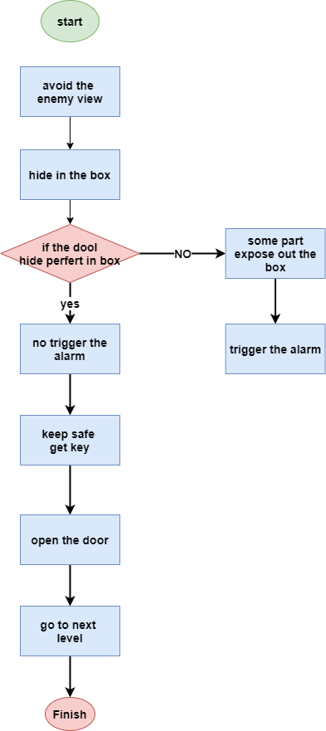

Slide 43
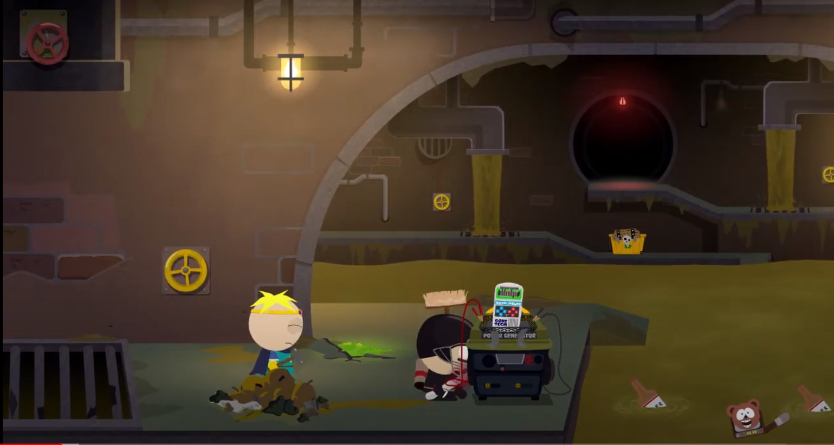
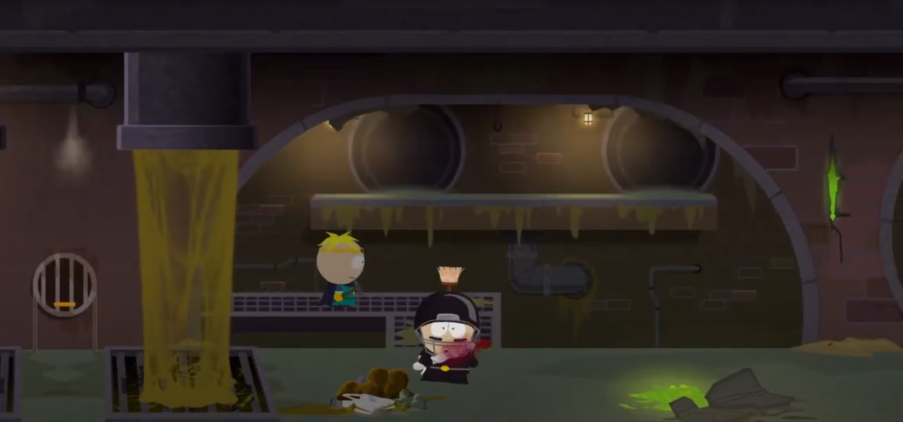
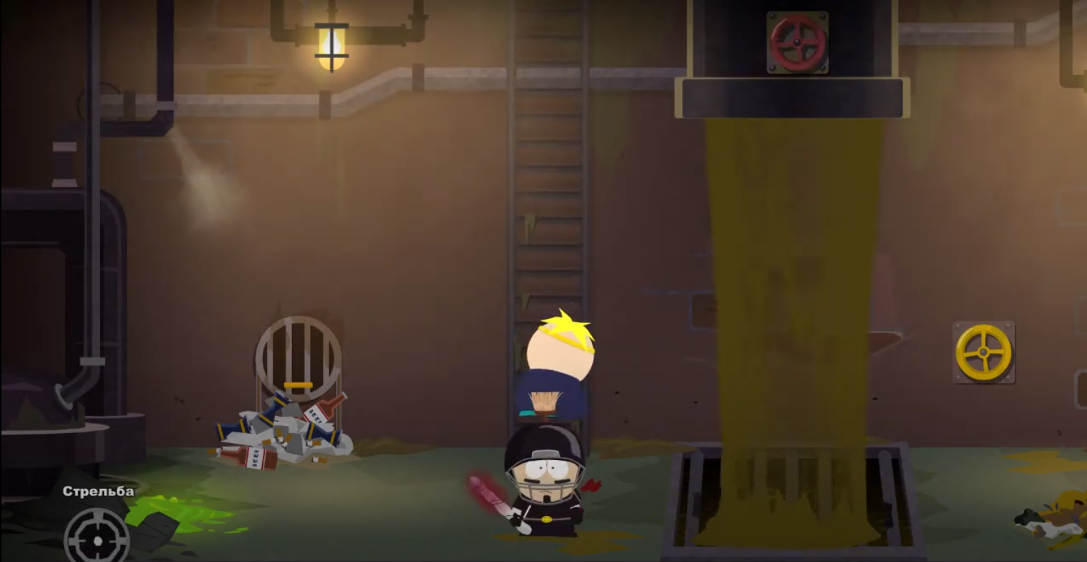
reference

Slide 44
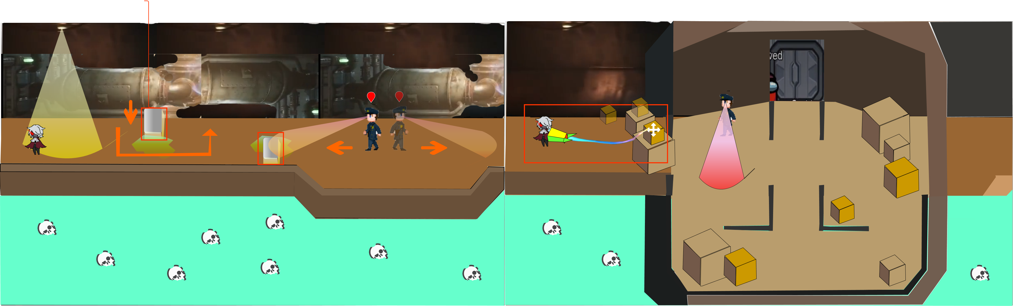

Slide 45
LEVEL DESIGN
NAN\ARNO

Slide 46
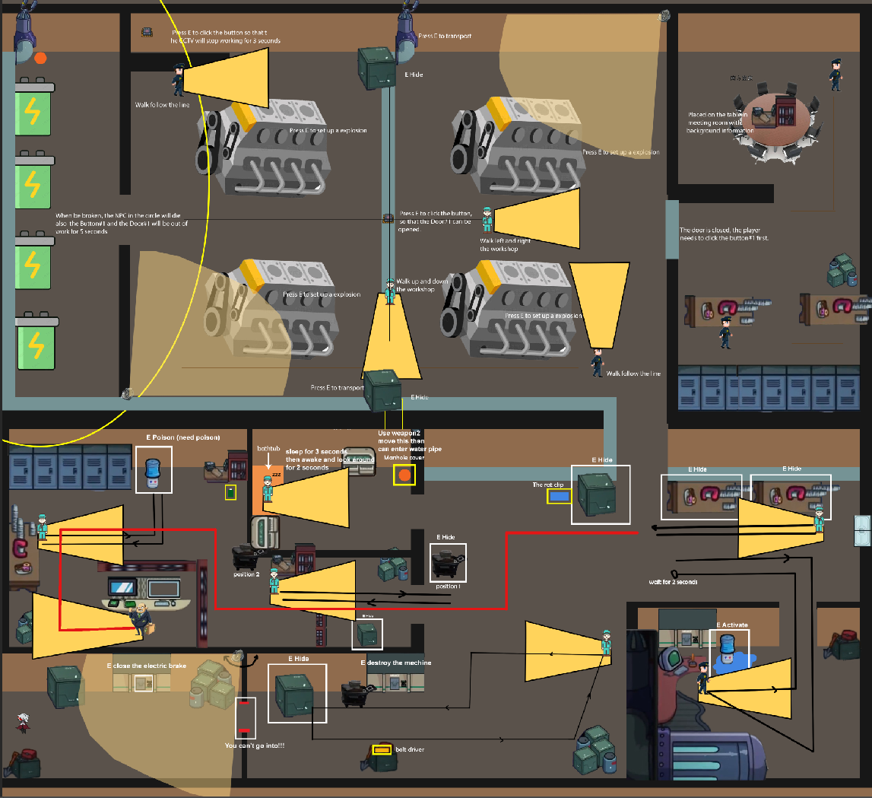
Level target:
Kill boss
Kill 5 security
Kill 2 worker

Slide 47
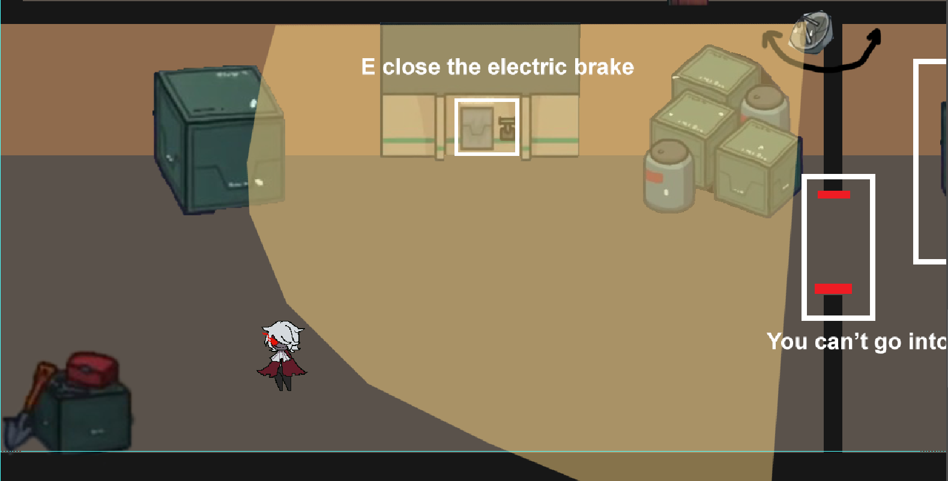
BEAT 1 ---Nan
Overview:
Player have to close the electric brake to close the detective door, go into the factory to kill people.

Slide 48
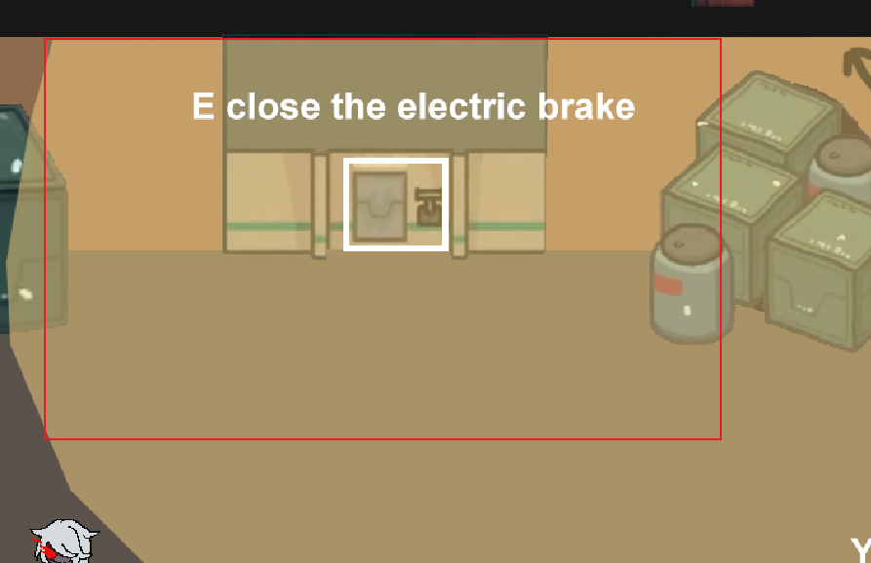
电力开关 electric brake
Program:
切换到武器二时，玩家靠近出现提示，具体范围为红色线框
When switching to weapon 2, players will be prompted to approach, and the specific scope is the red wireframe.
Tip： E close the electric brake

Slide 49
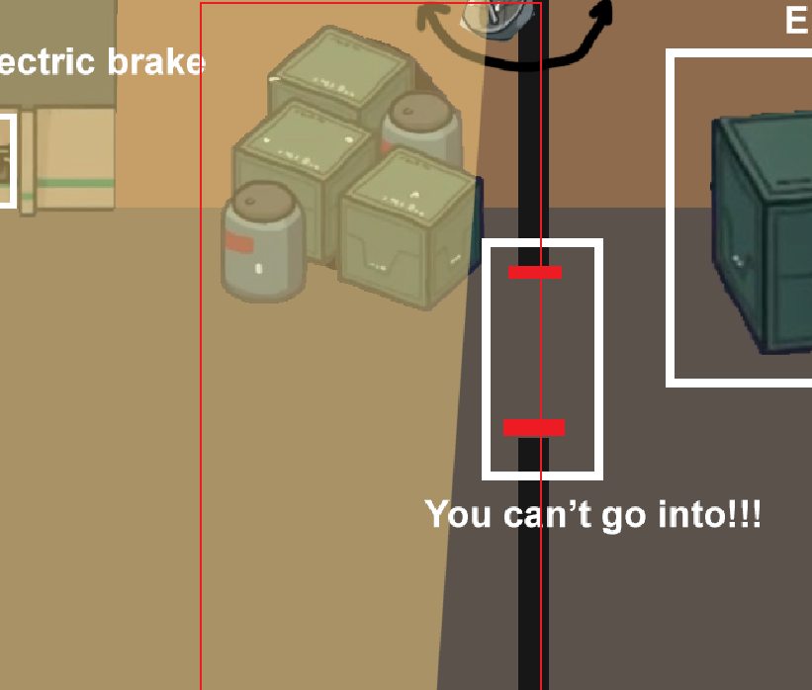
检测门 Detective door
Art:
Door opening and closing animation
Program:
At the beginning, the door is closed and sends out the detection light. After the player closes the switch, the door opens and the detection light closes. After the player enters, the door closes and the detection light opens.
Players will be prompted if he close the door, the specific scope is red wireframe.
Tip ： You can’t go into!!!

Slide 50
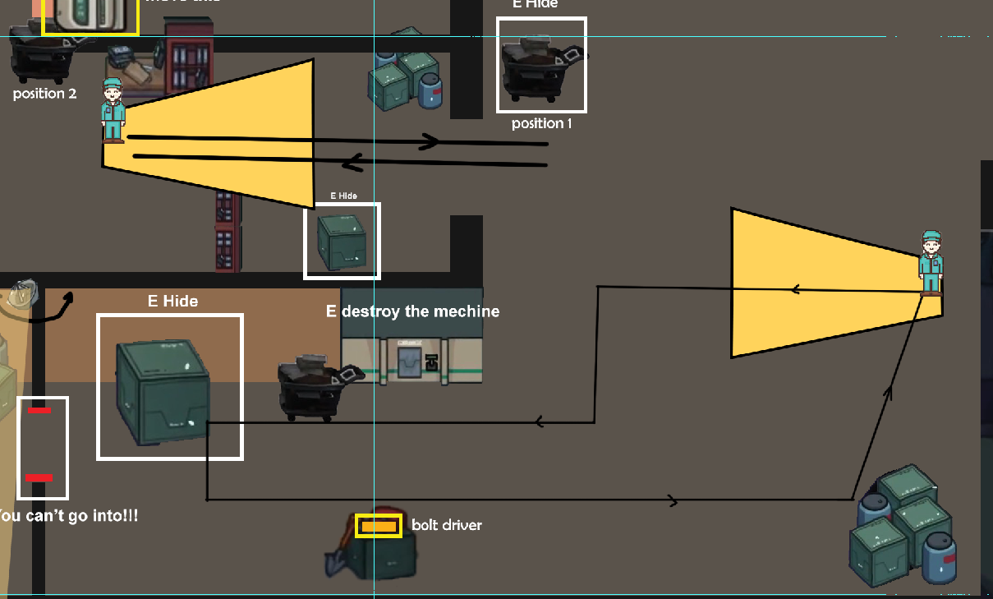
BEAT 2 ---Nan
Overview:
Player can use weapon2 to make trap or use weapon1 to kill target(without being seen).

Slide 51
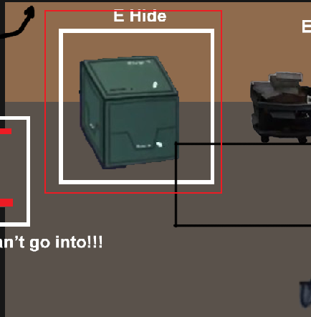
Hide Box
Program:
Players will be prompted when they are close. Players can hide themselves(no time limit, but player has to kill people in certain time). Patrol NPC will not find out player.
Tips： E Hide

Slide 52
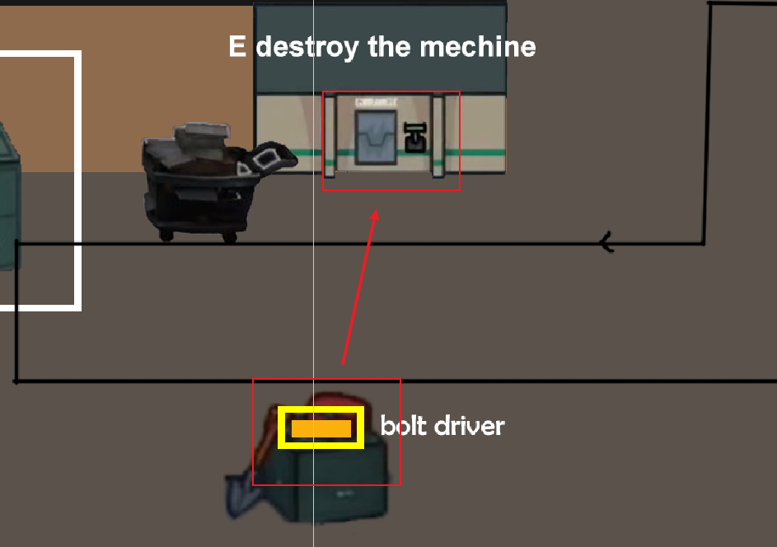
Program:
Player use weapon2 then lift bolt driver to destroy the electric machine.
If NPC come into range of the trigger, he will die.
Art:
NPC Electrocuted animation.

Slide 53
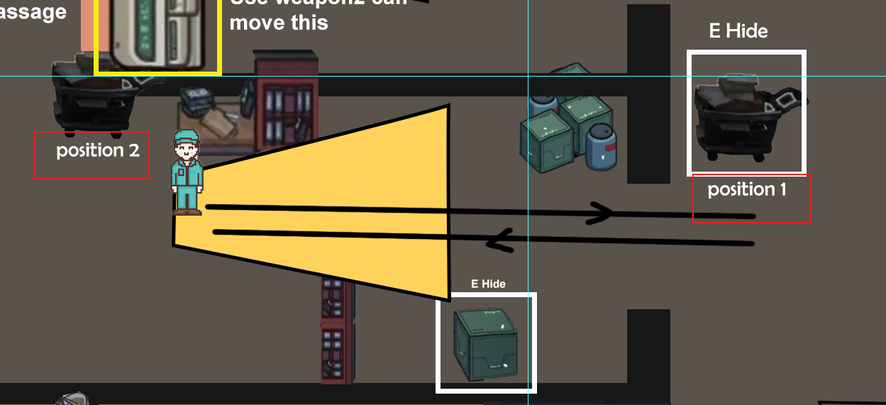
Program:
玩家靠近货架车会出现Hide提示，玩家一旦躲进去，旁边这个NPC就会停下来原来的路线，返回把这辆车推到目标点
Once the player gets close to the shelf car, a “hide” prompt will appear. Once the player hides in, the NPC next to him will stop the original route and return to push the car to the target point
美术：NPC推车动画
Art: NPC push cart animation

Slide 54
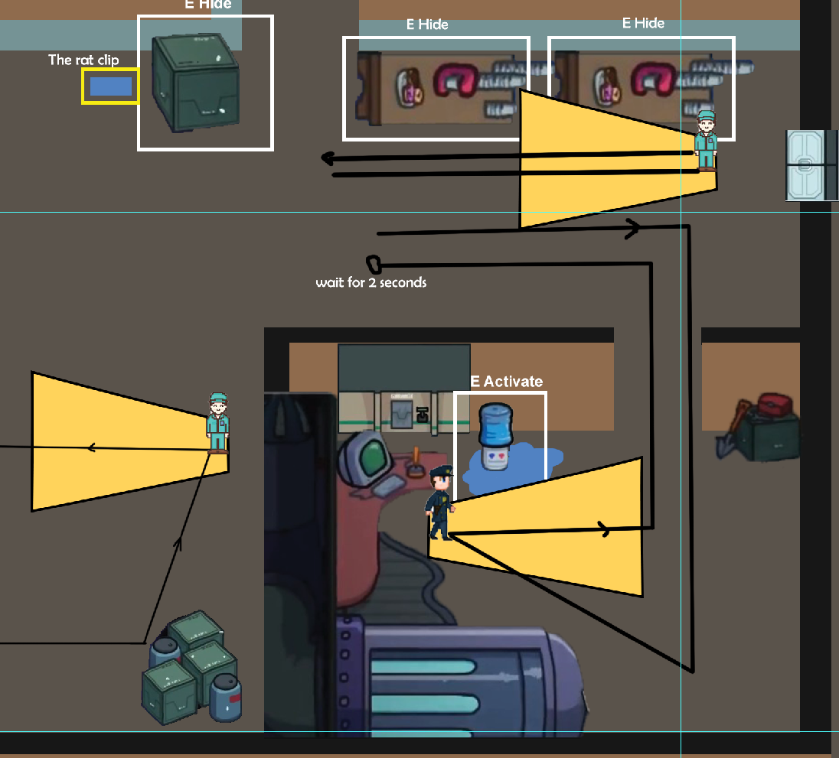
BEAT 3 ---Nan
Overview:
Security is an important target, players need to be careful not to be found here to use traps or find the right time to assassinate

Slide 55
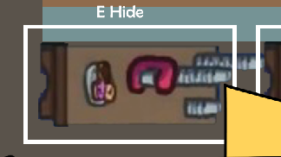
Hide Table
Program:
玩家靠近桌子在靠近白线框就会出现提示：Hide
Players close to the table, close to the white wire frame will be prompted: hide
美术：玩偶躲在桌子下的动画
Art: animation of doll hiding under the table

Slide 56

Program:
Players close can trigger electric shock trap, security close will be electrocuted to death(range is white line).
Art:
Security Electrocuted animation.

Slide 57

Program:
玩家用武器二举起老鼠夹可以放在任何位置，触碰到老鼠夹的NPC会死
The player can put the mousetrap in any position with weapon 2. The NPC who touches the mousetrap will die

Slide 58

BEAT 4 ---Nan
Overview:
The boss is the most important person here. Players must sneak into this room to assassinate

Slide 59


Program:
Players use weapon 2 to remove the well cover and transfer it to another location. Now the specific location has not been determined

Slide 60


Program:
Players can be prompted when they switch to the second skill
Tip:
E Push down the box

Slide 61

Program:
Use weapon 2 to lift the poison tank close to the water dispenser and you will be prompted: poison
After that, the NPC will die when it touches the water dispenser
The trigger of water dispenser is white wire frame

Slide 62

BEAT 5 ---Arno

Slide 63


Machines: Press E to delay an explosion for 5 seconds
贴近机器时弹出提示: Press E to set up a explosion
爆炸范围为黑框以内
玩家布置好机关后，机器右上角会显示倒计时5.4.3.2.1....然后爆炸
伴有火花特效
机器被成废铁，黑框内的人死亡

Slide 64


The electric box: Press E to broke the electric box
When be broken, the NPC in the circle will die
also the player will have 5 seconds to click the Button#1
损坏后会有冒电火花的特效，UI左上角会有倒计时，数字倒计时或者秒表展示皆可
同时会吸引圆圈内的保安来检查电箱，当保安触碰损坏的电箱时，保安会被电死

Slide 65


Button#1: Press E to click the button,so that the Door#1 can be
opened.
Door#1: Closed, only if the Button#1 is clicked, the door will open.
靠近Button#1时，
如果玩家尚未设置电箱机关，系统显示：首先设置电箱机关
如果玩家设置了电箱机关，系统显示：按E键打开Door#1
按了之后，Door#1会保持打开状态
靠近提示：需要先去启动按钮#1
当玩家按了Button#1后，门会朝上移动打开，玩家将能够直接通过进入办公室

Slide 66

Button#CCTV: Press the button to close the CCTV for 3 seconds
按下开关后，UI右上角会有倒计时显示监控的关机时间
倒计时结束后监控恢复状态，如果再次按下按钮，则倒计时重新开始
靠近后显示： Press E to close the CCTV

Slide 67

Information: Press E to read the document
作用为补充游戏背景故事，非强制性可收集要素

Slide 68


水管：靠近水管的一侧时可以快速传送到另一侧
靠近时提示：Press E to transport
动画效果：玩家直接闪现到另一边
BOX：按E键可以躲藏在内
靠近提示： Press E to hide
动画效果：玩家钻进箱子内

Slide 69

靠近NPC且不在NPC视野范围内，可按E直接暗杀
NPC发现死尸（死尸出现在NPC的视野范围内）
NPC会跟着设定路线走到离死尸最近的地方站桩3-5s，站桩是视野范围会始终朝向死尸，时间结束后NPC会继续回到设定路线来回巡逻，站桩时间不会显示给玩家看
人物AI：
保安AI：保安沿着设定路线来回行走巡逻，没到直角边时停止3s后继续前行
工人AI：工人沿着设定路线来回行走
需要刺杀4位保安
工人可杀可不杀

Slide 70
Checkpoint process
Enter the level
Transport by the Water pipe
Close the CCTV
Break the Electric Box
Click the Button#1
Enter the office

Slide 71
AI design
Nan

Slide 72

camera
夹角为60度 扇形 （变量，设计师需要调整）
运动范围为 180度 （变量， 需要调整）
半径暂定 13个人偶长度 （变量 需要调整）
人偶在摄像机的探测范围内，则触发警报

Slide 73



Normal worker
脚下发出的探测范围，上下距离超过玩偶的击杀距离（所以这个距离需要给个变量值作调整，暂定长度为攻击距离的1.2倍），意思是为了不让玩偶靠近他的时候（除了背后的情况）就轻易杀了他。
视线可以被场景里的物体和墙体遮挡，遮挡时，视线会变化，参考清洁工。
玩偶躲进可以躲藏的箱子时，不会被normal worker 发现。
行径路线就是layout的黑线

Slide 74

security
会在某个地方（属于巡逻路径上）停留一定时间
需要停留的地方设计师可以自己决定，请给我们一个transform 变量
停留的时间也需要调整
巡逻路径就是画出的路径

Slide 75

Boss
巡逻路径长
需要玩家对他造成三次伤害才会死亡（陷阱和背刺都算一次伤害）
如果受到伤害后会在受到伤害点停留一定秒数（设计师需要调整）

Slide 76

Interactive hints in the level：
判定规则：
以角色为中心，有一个与角色身位同宽的圆圈作为判定范围；
此圆圈可以作为特效让玩家看到；
操作提示：
1.当玩偶接近关卡中的可互动物体时，会显示的信息有：
a.靠近之后，在判定区域内的物体加上了外描边；
b.显示，与此物体互动的按键以及按键触发的功能；
（说明：按键触发的功能只会告诉玩家，按下键之后，物体会进行的行为，但不会告诉玩家结果；结果需要玩家操作完之后自行进行观察； ）

Slide 77


Maximum display on the same screen interface！
1.报警的倒
计时提示：5s
2.连击有属性加成；版本2.0
3.周围发现案发现场的NPC会变警觉的警觉标志
警觉之后NPC的移动速度加快。
6.暗杀的目标
4.警察会去到的案发现场有警察的标记
5.警察来了的标志
7. 警察头像的位置可以提示玩家警察过来的方向；

Slide 78



触发报警的两种情况： 1.玩偶走动时被NPC发现，NPC跑开，报警； （简单版，NPC原地报警） 2.玩偶杀人时被其它NPC看见，其它npc跑开，报警； 报警之后，进入警报状态： a.倒计时十秒,警察从屏幕外进入标记警徽的调查区域调查； 十秒内，玩偶未被发现，十秒后警察就离开； 被发现，则进入逮捕状态 （DEMO 版本若没法实现逮捕状态，则先实现 被警察发现，就会游戏结束） B.倒计时十秒,警察从屏幕外进入标记警徽的调查区域调查； 十秒内，玩偶被发现，则进入逮捕状态； 逮捕倒计时是新计时10s; 警察会追击玩偶，玩偶进入逃跑状态； 十秒内没被抓到，则警察离开； 被抓到游戏结束！！ 逮捕状态行为开发需要时间长，先做第一种状态； 先不做追击状态；
Two states that trigger an alarm

Slide 79

Failure
Show bonus for killing in special way
Title
Number of successfully killed targets
Time to survive this time

Slide 80

success
Number of successfully killed targets
Show bonus for killing in special way
Title
Time to survive this time

